Slide 1
Working with Databases in Python
Entity | A single object, place, person, or thing, e.g. player.
Attribute | Properties or characteristics of an entity, e.g. player name, player score.
Field | Also known as an attribute. It is the properties or characteristics of an entity.
Record | A collection of attributes for a single entity.
Database | A structured and organised method for storing data, most often contains one or more tables. A database holds multiple records.
Table | A tables contain records (rows) of data, and a table is identified by a name (e.g. “Songs" or “Members").
SQL (pronounced S-Q-L or Sequel) stands for Structured Query Language. It is a declarative language used for querying and updating tables in a relational database It can also be used to create tables You can create SQL statements in a programming language such as Python to access and manipulate a database

Slide 2
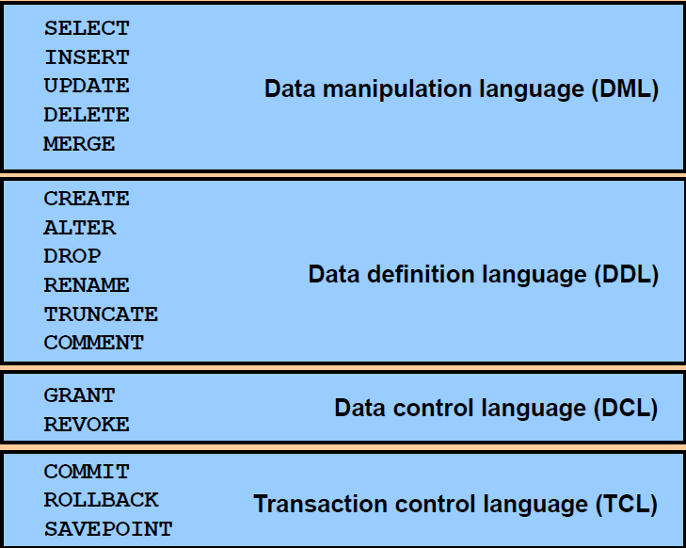
SQL

Slide 3
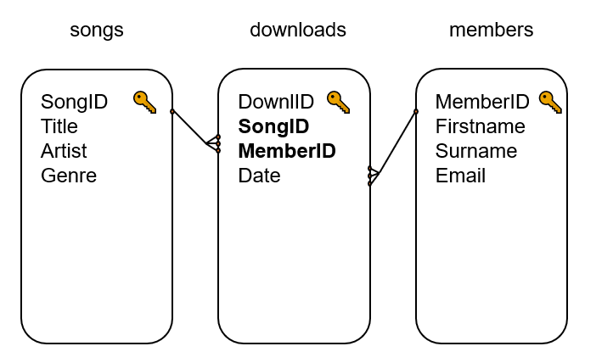
Structure of a Database
• Each entity in a database is represented by a table
• The tables in a relational database are usually referred to as relations
• Therefore, a relational database contains one or more relations
• A relation has rows, each row containing one record
• The columns in the relation each contains one field (i.e., attribute) belonging to the records.
Relational databases: The Entity relationship diagram represent the database we are going to create and/or use.
The database above has three tables. All linked together using relationships. Data is not repeated because it is linked to
the source table’s primary key using the foreign key. A primary key is unique to the original source of the data. It cannot
be repeated. When you link to a source table’s primary key, you use a foreign key. A foreign key can be repeated
because it is a link back to the primary key in the source table. Therefore, the tables with the primary keys must first be
created before we can create the table(s) where the primary keys will become foreign keys. This is also important when
you are adding data to a table with one or more foreign keys.
The data/record you add (the primary key of that data),
must first exists in its primary table (original sources of data).
Moreover, in a relational database all data
can be updated at the original source.

Slide 4
Connecting to SQLite Database
1. import the sqlite3 module
2. Create a connection object that represent the database you want to create and/or use in order to
use the SQLite module imported in step 1 this
ensures that we can perform various database operations.
Now create a cursor object after establishing a connection in step 2, and call its execute() method to perform SQL commands
Link to read about SQLite https://docs.python.org/3/library/sqlite3.html
SQLite DB: Important Attributes and Functions of Connection

Slide 5
QLite DB: Important Attributes and Functions of Connection
Close: con.close() Closes the connection instantly.
Commit con.commit(): Commits any pending transaction to the database.
Rollback: con.rollback(): Rolls back to the start of any pending transaction. In other words: this cancels any non-committed transaction to the database.
Cursor = con.cursor(): The cursor object is used to execute SQL commands and queries. Returns a Cursor object. This is used to do transactions on the database.
Fetchone() method Fetches the next row of a query result set, returning a single sequence, or None when no more data is available.
Fetchall() method, which fetches all rows from the last executed statement.
Executemany() method, to insert multiple rows into a table.
Execute() method, when the number of records to be inserted is small and can be written directly in the code
The SQL statement may be parametrized (i. e. placeholders instead of SQL literals).

